Slide 1
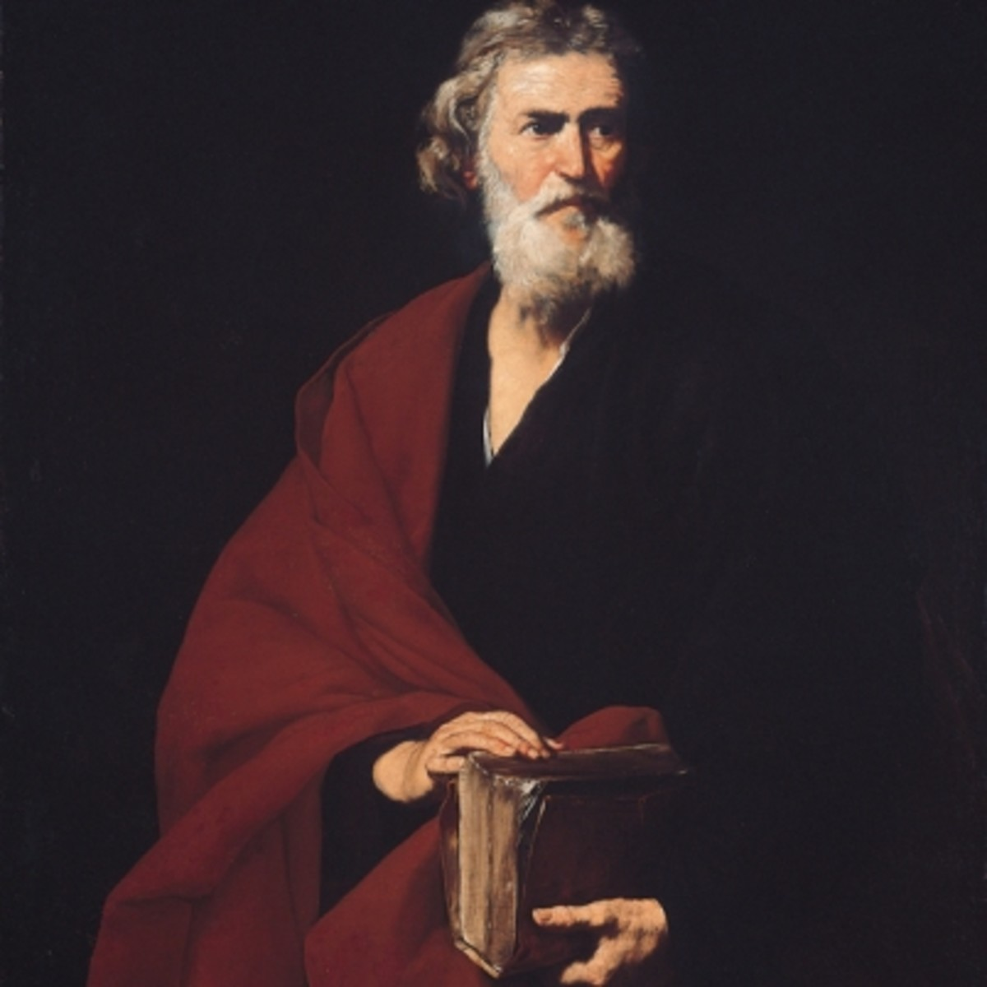
Monday 21st September Saint Matthew, Apostle, Evangelist Feast This week's theme is Inclusion. We begin with the sign of the cross.

Slide 2
What does
the Word say?
Scripture- Romans 12:15-18
Be happy with those who are happy, weep with those who weep. Have the same concern for everyone. Do not be proud, but accept humble duties. Do not think of yourselves as wise. If someone has done you wrong, do not repay him with a wrong. Try to do what everyone considers to be good. Do everything possible on your part to live in peace with everybody.

Slide 3
Reflection & Discussion
Today is the feast day of St Matthew. He was a Jew who worked for the occupying Roman forces, collecting taxes from other Jews. The Romans didn't care that the "tax farmers" got more money for themselves. Hence, they were generally hated and deemed traitors by their fellow Jews. So it was shocking to hear Jesus call such a man to be one of his disciples. Matthew got Jesus in further trouble by having a sort of going-away party at his house. The Gospel tells us that "many" tax collectors and "those known as sinners" came to the dinner. The Pharisees were still more badly shocked. What business did the supposedly great teacher have associating with such immoral people? Jesus' answer was, "Those who are well do not need a physician, but the sick do. Go and learn the meaning of the words, 'I desire mercy, not sacrifice.' I did not come to call the righteous but sinners". Jesus is not setting aside ritual and worship; he is saying that loving others is even more important.
Everyone of us has been guilty one time or another of excluding people from our own circle of friends. We'd heard "something" about that person, we judge someone based on their appearance. Jesus has shown by example everyone is important, and being inclusive, accepting one another, is the way to live. What would have happened to Matthew had Jesus not included him. Matthew became one of the 12 disciples, Apostle, missionary, evangelist and author.
Take a minute and reflect if you have ever been unfairly excluded from a group? How did that feel? Have you ever made anyone feel that way? Are you the type of person that excludes or includes people?

Slide 4
Prayer
An opportunity for anyone to say what they would like to pray for today.
Dear Lord,
Help us live your Word here on earth.That we would be happy with those who are happy, weep with those who weep. We pray that when the opportunity arises, we would welcome those who are different and do everything possible on our part to live in peace with everybody.
Amen.

Slide 5
Tuesday 22nd September This week's theme is Inclusion. We begin with the sign of the cross.

Slide 6
What does
the Word say?
Scripture-
1 Corinthians 12:12-14
Christ is like a single body, which has many parts; it is still one body, even though it is made up of different parts. In the same way, all of us, whether Jews or Gentiles, whether slaves or free, have been baptized into the one body by the same Spirit, and we have all been given the one Spirit to drink. For the body itself is not made up of only one part, but of many parts.

Slide 7
Reflection & Discussion
The Body of Christ, like all bodies, is comprised of many parts. There are limbs, organs, and various members that, when left alone, are useless, but when assembled make up the entire body. According tio the scripture it means each Christian is an equal part of the body of Christ. Every Christian possesses a gift and is called to use it in service within the body to build up the body of Christ, to strengthen the body and to carry out its purpose within the world. Each member of the body of Christ is also called to serve the church through his or her natural gifts and abilities. This service is offered out of devotion to Christ for the sacrifice He made on the cross, providing them with eternal life in heaven. The diversity of gifts, each supporting the other, makes the body strong. We are called to promote truth and unity and to love one another the very essence of inclusiveness.
Take a moment to evaluate your life in light of these principles:
Are you actively serving God and sharing Him with others?
Are you contributing to peace and unity within the body?
Do you worship regularly?

Slide 8
Prayer
An opportunity for anyone to say what they would like to pray for today.
Heavenly Father,
Thank you for making me part of your family. It is my desire to be an active part of Your church by serving, promoting unity, and sharing my faith with others. Give me opportunities to accomplish these things for Your glory.
Amen

Slide 9
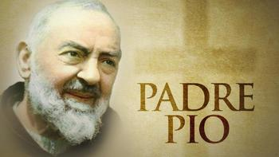
Wednesday 23rd September Saint Pius of Pietrelcina (Padre Pio) This week's theme is Inclusion. We begin with the sign of the cross.

Slide 10
What does
the Word say?
Scripture- John 3:16-17
For God loved the world so much that he gave his only Son, so that everyone who believes in him may not die but have eternal life. For God did not send his Son into the world to be its judge, but to be its savior.

Slide 11
Reflection & Discussion
Francesco Forgione widely known as Padre Pio was born on the 25th of May 1887 in Pietrelcina, Italy. His followers attributed several miracles to his intervention. Other people, including those from within the Catholic Church, were more sceptical about his supernatural experiences.
Padre Pio was a generous dispense of divine mercy, making himself available to all by welcoming them, by spiritual direction and especially by the administration of the sacrament of Penance. The ministry of the confessional, which is one of the distinctive traits of his apostolate.
Saint Pio most famous quote is “Pray, hope, and don’t worry. Worry is useless. God is merciful and will hear your prayer”
Sometimes when we stress about the unknown and worry about the issues we are facing we forget that our Lord Jesus has overcome the world. God listens to our prayers, we just need to trust that he will help us through hard times. God does not separate himself from us, he has given the very best of himself so that we can be saved. “For God so loved the world that he gave his only son...
Take a moment to reflect what it means to give the very best of yourself , to sacrifice your most precious belonging for the sake of someone else that you love. How about a stranger?

Slide 12
Prayer
An opportunity for anyone to say what they would like to pray for today.
Dear God,
I humbly come before you today in appreciation for all that you have done for me. Thank you Jesus for your sacrifice so that I may be reconciled with God. Help me be a loving example like Jesus who welcomes all into the kingdom of Heaven.
Amen

Slide 13
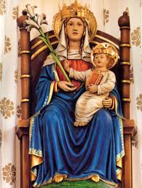
Thursday 24th September Our Lady of Walsingham This week's theme is Inclusion. We begin with the sign of the cross.

Slide 14
What does
the Word say?
Scripture- John 3:16-17
For God loved the world so much that he gave his only Son, so that everyone who believes in him may not die but have eternal life. For God did not send his Son into the world to be its judge, but to be its savior.

Slide 15
Reflection & Discussion
Our Lady of Walsingham is a title of the Blessed Virgin Mary. In 1061 an English noblewoman named Lady Richeldis of Walsingham had a structure built named "The Holy House" which later became a shrine and place of pilgrimage. It’s a place where people come together and everyone is welcome to reflect and commune with Our Lady.​
Why would someone go on a pilgrimage?
Why do you think it is important that everyone feel welcome?
What kind of things can we do to make people feel included?
https://youtu.be/rmjdZFwvlTY

Slide 16
Prayer
An opportunity for anyone to say what they would like to pray for today.
Hail Mary,
Full of Grace,
The Lord is with thee.
Blessed art thou among women,
and blessed is the fruit
of thy womb, Jesus.
Holy Mary,
Mother of God,
pray for us sinners now,
and at the hour of our death.
Amen.

Slide 17
Friday 25th September This week's theme is Inclusion. We begin with the sign of the cross.

Slide 18
What does
the Word say?
Scripture- John 13:34-35
“A new command I give you: Love one another. As I have loved you, so you must love one another. By this everyone will know that you are my disciples, if you love one another.”

Slide 19
Reflection & Discussion
In Christ’s new command, the significant words are “as I have loved you.” Christ’s command to love “as I have loved you” is the “new commandment.” This depth of love takes the Christian to a whole new way of expressing love for others. The love that Christ had and continues to have for His followers is infinitely more profound than the love expressed in “you shall love your neighbour as yourself.” When Christians express love toward others, it should not be just as we love ourselves, but as Christ loves us.
Putting into practice His “as I have loved you” kind of love, Jesus Christ willingly paid the price for our sins. As He explained, “Greater love has no one than this, than to lay down one’s life for his friends” (John 15:13). The great cost of our sin was His suffering, torture and horrific death. That is the self-sacrificial love He showed for all mankind. Without that love, we would have no hope and no opportunity to live forever.
That is the kind of love that Christ has for His Church and, through His new commandment, it is the love He expects Christians to have.
Take a moment to reflect upon the important people who are in your life, do you demonstrate a self-sacrificial love with your actions?

Slide 20
Prayer
An opportunity for anyone to say what they would like to pray for today.
Loving Lord,
Your Son came and showed the ultimate gift of love. He had done nothing wrong and yet gave his own life as a sacrifice for mine. I pray that you overflow my hear with a love so powerful that it shows in my words, actions, and attitude. Help me to love others without hesitation and without boundaries.
Amen

