Slide 1
The Internet
How can we keep our children safe?
Notes:
Start with Film cyberbullying

Slide 2
Internet
http://www.bbc.co.uk/news/uk-wales-27302417
I think we would all agree that the internet is a fantastic tool and one that we should be encouraging our young people to be engaging with, but we hear such horror stories.
What are the facts and how safe are our children on-line?

Slide 3
How safe are your children on-line?
The internet is getting safer, but for our children, the risks are not as obvious, so it can be confusing!

Slide 4
The Facts
87% of UK children aged 9-16 years old do not regularly post or disclose personal information about themselves to people they met online.
14% of them have sent personal information about themselves to others.
7% have sent images.

Slide 5
The Facts
18% of children have encountered harmful content online.
28% of 11-16 year olds have been deliberately targeted and bullied either by an individual or group through the use of mobile phones or the internet.
For over a quarter of these they had been constantly bullied by the same person or group over a long time.
However, there has been a reduction in the percentage of children reporting cyber bullying, from 33% in 2009 to 17% in 2011

Slide 6
The Facts
11% of UK children have encountered sexual images online.
8% of UK 11-16 year olds say they have seen online sexual images including nudity.
Sexting’ is prevalent among young people, with around 40% saying they knew friends who carried out such a practice.

Slide 7
The Facts
Accounts of online groomers suggest evidence of resilient young people that refuse to engage with them online.
The key features of young people’s resilience (from offenders accounts and the academic literature) were the ability to:
recognise risk and fend off any approach they considered‘weird’
understand safety messages
feel confident about rejecting advances and informing others.
HOWEVER…..

Slide 8
Disclosure
Boys in particular tended to be more resistant to the idea of telling anyone about inappropriate online approaches.
Girls tended to tell a friend.
There was some resistance to telling parents or carers, influenced by a fear that their computer privileges would be removed.

Slide 9
Other Risks
Over one in three adolescents have been reported to gamble in money-free mode with one large UK study reporting that 28% of 11- to 15-year olds had done so within the last week.
19% of UK 11-16 year olds have seen one or more type of potentially harmful user generated content, rising to 32% of 14-16 year old girls.
Most common are hate messages (13%), followed by anorexia/bulimia sites and sites talking about drug experiences (both 8%).
Few (2%) have visited a suicide site

Slide 10
Other Risks
Most teenagers use Youtube regularly and on this site they can access adult materials without any restrictions.
Sites like these are particularly difficult to monitor.
One in ten children between the ages of 12 and 13 are worried that they are "addicted" to watching pornography.
One in five members of the same age group think watching explicit content is normal, according to a study by children's charity NSPCC.
The main misuse of personal data experienced by UK children is when someone has used their password or pretended to be them (10%).

Slide 11
To Summarise – the dangers children encounter daily
Bullying
Pornography and sexual images
Sexting
Grooming
Inappropriate video content
Harmful user generated content (drugs, anorexia, suicide)
Gambling
Sharing or stealing of private information
‘Friends’ they don’t actually know

Slide 12
It’s a mine field!

Slide 13
Being a parent is a difficult job!
Do you supervise and monitor what your child is doing on the internet?
Do you know what sort of things your children like doing on the Internet ?
Do you have concerns about your children’s use of the Internet ?
Do you discuss their internet use with them?

Slide 14
OUT OF SCHOOL
Sometimes no supervision, filtering or monitoring
IN SCHOOL
Supervised, filtered & monitored
Mind the Gap: Over 80% spend between 2 and 4+ hours on-line every day
On average 70% say they use the Internet privately without their parent’s supervision

Slide 15
Our children can be pretty good at spotting some dangers. The problem is, often they learn from experience. They don’t always like to tell parents out of a fear of their computer privileges being removed. So what can we do about this?

Slide 16
Communication is key
Talk regularly to them about what they are doing, who they talk to and encourage them to report anything suspicious with out fear of reprisals. Agree a ‘no blame’ rule.
Keep them informed and educated about current developments and news stories
Respect their privacy as far as you can without endangering them

Slide 17
Talk to their friends parents to establish what controls they have and share tips
Teach them to set their profiles to private (and to check them regularly) and make sure they don’t let people they don’t know join their network
Explain the potential impacts of other people sharing their images and vice versa

Slide 18
Conversation starters…
Ask your children to tell you about the sites they like to visit and what they enjoy doing online.
Ask them about how they stay safe online. What tips do they have for you, and where did they learn them? What is OK and not OK to share?
Ask them if they know where to go for help, where to find the safety advice, privacy settings and how to report or block on the services they use.
Encourage them to help. Perhaps they can show you how to do something better online or they might have a friend who would benefit from their help and support.
Think about how you use the internet as a family. What could you do to get more out of the internet together and further enjoy your lives online?

Slide 19
What to do if a child has come to you and needs help
Communication with your child is essential. Talk to them and reassure them that they can always come to you if something upsets or worries them online.
Save the evidence wherever possible. Evidence may include screen shots taken on a laptop or mobile device, emails, texts or online conversation histories. If you do need to make a report, evidence gathered will make it easier to show exactly what has taken place.
Knowing who to report to is a really useful step to resolve many issues, so do familiarise yourself with the services available below. Depending on what has happened, it might be necessary to let your child's school know too.

Slide 20
So how would you know if something was wrong?
Symptom Checker – signs that your child might be a victim:
Your child becomes secretive about what they are doing online, password protects their phone
Uses computers outside of home, such as at homes of friends, Internet cafes, or libraries
Has a sudden decline in homework or grades
Doesn't feel well, complains of headaches, stomach aches, or nervousness
Is restless, has difficulty sleeping
Shows changes in behaviour or has mood swings
Sudden change in friendship groups
Does not want to go to school or socialise
Avoids telling you who their online friends are
No longer wants to use the computer or mobile phone

Slide 21
Where to report online concerns or risks

Slide 22
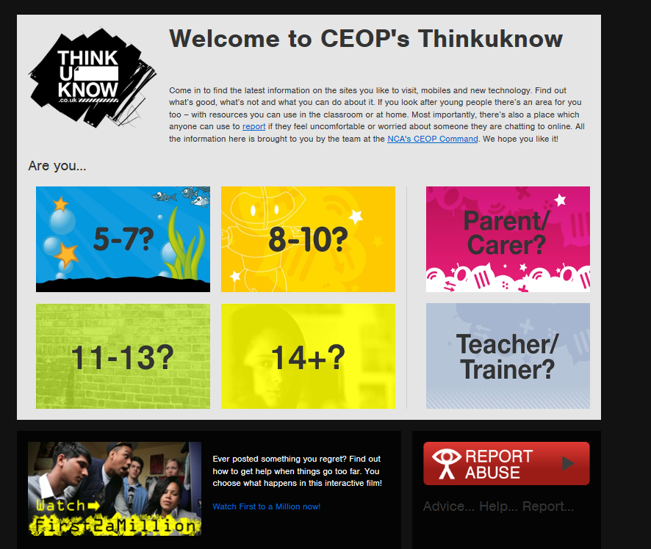
Useful websites
CEOP
https://www.thinkuknow.co.uk
http://www.childnet.com

